Slide 1
Lecture 44-45
Network Security
Department of Computer Science and Engineering
Chitkara University, Punjab

Slide 2
Security Services
Cryptography
Public and Private key
Digital Signatures
Access Control List

Slide 3
Security Services

Slide 4
Security Services
Network security includes five services:
Four of these services are related to message exchanged using the network:
Message confidentiality
Integrity
Authentication
Nonrepudiation
The fifth service provides entity authentication or identification.

Slide 5
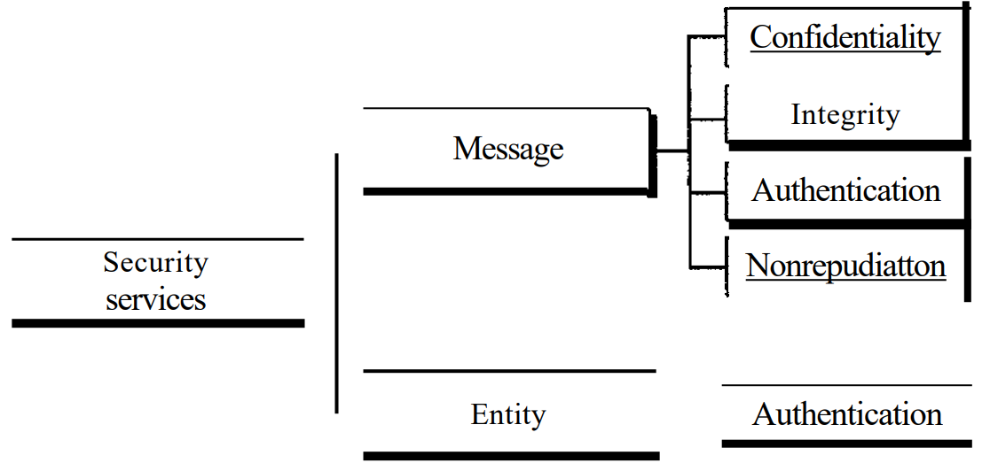
Security Services

Slide 6
Security Services
Message Confidentiality:
Message confidentiality or privacy means that the sender and the receiver expect confidentiality.
The transmitted message must make sense to only the intended receiver.
To all others, the message must be garbage.
When a customer communicates with her bank, she expects that the communication is totally confidential.

Slide 7
Security Services
Message Integrity:
Message integrity means that the data must arrive at the receiver exactly as they were sent.
There must be no changes during the transmission, neither accidentally nor maliciously.
As more and more monetary exchanges occur over the Internet, integrity is crucial.
For example, it would be disastrous if a request for transferring $100 changed to a request for $10,000 or $100,000. The integrity of the message must be preserved in a secure communication.

Slide 8
Security Services
Message Authentication:
Message authentication is a service beyond message integrity.
In message authentication the receiver needs to be sure of the sender's identity and that an imposter has not sent the message.
Message Nonrepudiation:
Message nonrepudiation means that a sender must not be able to deny sending a message that he or she, in fact, did send.
The burden of proof falls on the receiver.
For example, when a customer sends a message to transfer money from one account to another, the bank must have proof that the customer actually requested this transaction.

Slide 9
Security Services
Entity Authentication:
In entity authentication (or user identification) the entity or user is verified prior to access to the system resources (files, for example).
For example, a student who needs to access her university resources needs to be authenticated during the logging process. This is to protect the interests of the university and the student.

Slide 10
Cryptography

Slide 11
What is Cryptography?
Cryptography derived its name from a Greek word called
“krypto’s” which means “Hidden Secrets”.
Cryptography is the practice and study of hiding information. It is the Art or Science of converting a plain intelligible data into an unintelligible data and again retransforming that message into its original form.
It provides Confidentiality, Integrity, and Accuracy.

Slide 12
PURPOSE OF CRYPTOGRAPHY
Authentication: The process of proving one's identity. (The primary forms of host-to-host authentication on the Internet today are name-based or address-based, both of which are notoriously weak.)
Privacy/confidentiality: Ensuring that no one can read the message except the intended receiver.
Integrity: Assuring the receiver that the received message has not been altered in any way from the original.
Non-repudiation: A mechanism to prove that the sender really sent this message.

Slide 13
PURPOSE OF CRYPTOGRAPHY
Consider two parties Alice and Bob.
Now, Alice wants to send a message m to Bob over a secure channel.
The sender’s message or sometimes called the Plaintext, is converted into an unreadable form using a Key k.
The resultant text obtained is called the Ciphertext. This process is known as Encryption.
At the time of receiving , the Ciphertext is converted back into the plaintext using the same Key k, so that it can be read by the receiver. This process is known as Decryption.

Slide 14

PURPOSE OF CRYPTOGRAPHY
Here, C refers to the Ciphertext while E and D are the Encryption and Decryption algorithms respectively.
Let’s consider the case of Caesar Cipher or Shift Cipher as an example. As the name suggests, in Caesar Cipher each character in a word is replaced by another character under some defined rules. Thus, if A is replaced by D, B by E and so on. Then, each character in the word would be shifted by a position of 1. For example:
Input Text: AABBHHEEKK
Output Text: BBCCIIFFLL

Slide 15
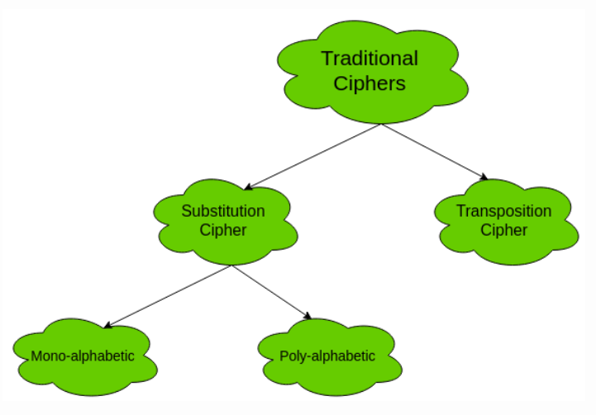
Types of Ciphers

Slide 16
Types of Ciphers
Mono-alphabetic Cipher
In mono-alphabetic ciphers, each symbol in plain-text (eg; ‘o’ in ‘follow’) is mapped to one cipher-text symbol. No matter how many times a symbol occurs in the plain-text, it will correspond to the same cipher-text symbol. For example, if the plain-text is ‘follow’ and the mapping is :
f -> g
o -> p
l -> m
w -> x
The cipher-text is ‘gpmmpx’.

Slide 17
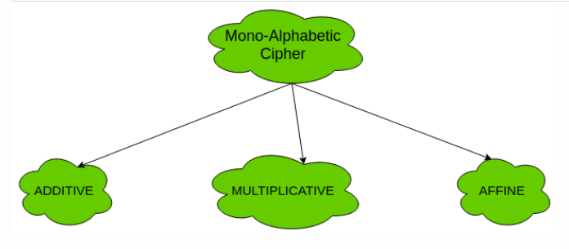
Types of Ciphers
(a). Additive Cipher (Shift Cipher / Caesar Cipher) – The simplest mono-alphabetic cipher is additive cipher. It is also referred to as ‘Shift Cipher’ or ‘Caesar Cipher’. As the name suggests, ‘addition modulus 26’ operation is performed on the plain-text to obtain a cipher-text.
C = (M + k) mod n M = (C – k) mod n
where, C -> cipher-text M -> message/plain-text k -> key

Slide 18
Types of Ciphers
(b). Multiplicative Cipher – The multiplicative cipher is similar to additive cipher except the fact that the key bit is multiplied to the plain-text symbol during encryption. Likewise, the cipher-text is multiplied by the multiplicative inverse of key for decryption to obtain back the plain-text.
C = (M * k) mod n M = (C * k⁻¹) mod n
where, k⁻¹ -> multiplicative inverse of k (key)
(c). Affine Cipher – The affine cipher is a combination of additive cipher and multiplicative cipher. It is relatively secure than the above two as the key space is larger. Here two keys k₁ and k₂ are used.
C = [(M * k₁) + k₂] mod n M = [(C – k₂) * k₁⁻¹ ] mod n

Slide 19
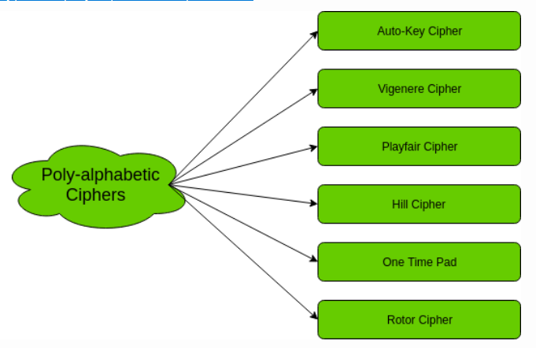
Types of Ciphers
Poly-alphabetic Cipher
In poly-alphabetic ciphers, every symbol in plain-text is mapped to a different cipher-text symbol regardless of its occurrence. Every different occurrence of a symbol has different mapping to a cipher-text. For example, in the plain-text ‘follow’, the mapping is :
f -> q o -> w l -> e l -> r o -> t w -> y
Thus, the cipher text is ‘qwerty’.

Slide 20
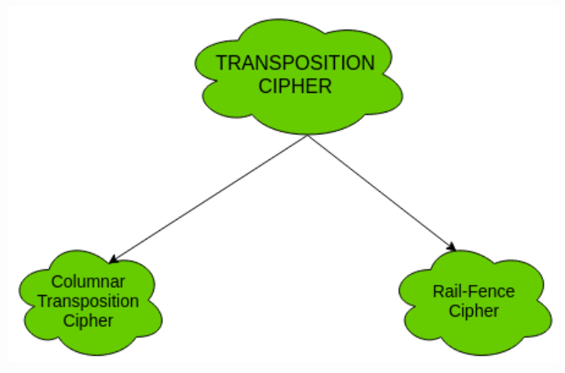
Types of Ciphers
2. Transposition Cipher: The transposition cipher does not deal with substitution of one symbol with another. It focuses on changing the position of the symbol in the plain-text. A symbol in the first position in plain-text may occur in fifth position in cipher-text.
Two of the transposition ciphers are:

Slide 21
Public and Private key

Slide 22
Public and Private key
Private Key:
In Private key, the same key (secret key) is used for encryption and decryption. In this key is symmetric because the only key is copy or share by another party to decrypt the cipher text. It is faster than the public key cryptography.
Public Key:
In Public key, two keys are used one key is used for encryption and another key is used for decryption. One key (public key) is used for encrypt the plain text to convert it into cipher text and another key (private key) is used by receiver to decrypt the cipher text to read the message.

Slide 23
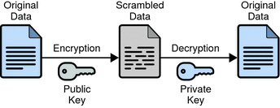
Use of Keys
Private keys are used for decrypting.
Public keys are used for encrypting.

Slide 24
Digital Signatures

Slide 25
Digital Signature
A digital signature is a mathematical technique used to validate the authenticity and integrity of a message, software, or digital document.
Key Generation Algorithms: Digital signature is electronic signatures, which assure that the message was sent by a particular sender. While performing digital transactions authenticity and integrity should be assured, otherwise, the data can be altered or someone can also act as if he was the sender and expect a reply.
Signing Algorithms: To create a digital signature, signing algorithms like email programs create a one-way hash of the electronic data which is to be signed. The signing algorithm then encrypts the hash value using the private key (signature key). This encrypted hash along with other information like the hashing algorithm is the digital signature. This digital signature is appended with the data and sent to the verifier.

Slide 26
Digital Signature
The reason for encrypting the hash instead of the entire message or document is that a hash function converts any arbitrary input into a much shorter fixed-length value. This saves time as now instead of signing a long message a shorter hash value has to be signed and moreover hashing is much faster than signing.
Signature Verification Algorithms : Verifier receives Digital Signature along with the data. It then uses Verification algorithm to process on the digital signature and the public key (verification key) and generates some value. It also applies the same hash function on the received data and generates a hash value. Then the hash value and the output of the verification algorithm are compared. If they both are equal, then the digital signature is valid else it is invalid.

Slide 27
Digital Signature
The steps followed in creating digital signature are :
Message digest is computed by applying hash function on the message and then message digest is encrypted using private key of sender to form the digital signature. (digital signature = encryption (private key of sender, message digest) and message digest = message digest algorithm(message)).
Digital signature is then transmitted with the message.(message + digital signature is transmitted)
Receiver decrypts the digital signature using the public key of sender.(This assures authenticity, as only sender has his private key so only sender can encrypt using his private key which can thus be decrypted by sender’s public key).

Slide 28
Digital Signature
The receiver now has the message digest.
The receiver can compute the message digest from the message (actual message is sent with the digital signature).The message digest computed by receiver and the message digest (got by decryption on digital signature) need to be same for ensuring integrity.

Slide 29
Access Control List

Slide 30
Access Control List
Access-list (ACL) is a set of rules defined for controlling the network traffic and reducing network attack. ACLs are used to filter traffic based on the set of rules defined for the incoming or out going of the network.
ACL features –
The set of rules defined are matched serial wise i.e matching starts with the first line, then 2nd, then 3rd and so on.
The packets are matched only until it matches the rule. Once a rule is matched then no further comparison takes place and that rule will be performed.
There is an implicit deny at the end of every ACL, i.e., if no condition or rule matches then the packet will be discarded.

Slide 31
Access Control List
Once the access-list is built, then it should be applied to inbound or outbound of the interface:
Inbound access lists – When an access list is applied on inbound packets of the interface then first the packets will processed according to the access list and then routed to the outbound interface.
Outbound access lists – When an access list is applied on outbound packets of the interface then first the packet will be routed and then processed at the outbound interface.

Slide 32
Access Control List
Types of ACL – There are two main different types of Access-list namely:
Standard Access-list – These are the Access-list which are made using the source IP address only. These ACLs permit or deny the entire protocol suite. They don’t distinguish between the IP traffic such as TCP, UDP, Https etc. By using numbers 1-99 or 1300-1999, router will understand it as a standard ACL and the specified address as source IP address.
Extended Access-list – These are the ACL which uses both source and destination IP address. In these type of ACL, we can also mention which IP traffic should be allowed or denied. These use range 100-199 and 2000-2699.

Slide 33
Access Control List
There are two categories of access list:
Numbered access list – These are the access list which cannot be deleted specifically once created i.e if we want to remove any rule from an Access-list then this is not permitted in the case of numbered access list. If we try to delete a rule from access list then the whole access list will be deleted. The numbered access list can be used with both standard and extended access list.
Named access list – In these type of access list, a name is assigned to identify an access list. It is allowed to delete a named access list unlike numbered access list. Like numbered access list, these can be used with both standard and extended access list.

Slide 34
Access Control List
Rules for ACL –
The standard Access-list is generally applied close to the destination (but not always).
The extended Access-list is generally applied close to the source (but not always).
We can assign only one ACL per interface per protocol per direction, i.e., only one inbound and outbound ACL is permitted per interface.
We can’t remove a rule from an Access-list if we are using numbered Access-list. If we try to remove a rule then whole ACL will be removed. If we are using named access lists then we can delete a specific rule.
Every new rule which is added into the access list will be placed at the bottom of the access list therefore before implementing the access lists, analyse the whole scenario carefully.
As there is an implicit deny at the end of every access list, we should have at least a permit statement in our Access-list otherwise all traffic will be denied.
Standard access lists and extended access lists cannot have the same name.

Slide 35
Access Control List
Advantages of ACL –
Improve network performance.
Provides security as administrator can configure the access list according to the needs and deny the unwanted packets from entering the network.
Provides control over the traffic as it can permit or deny according to the need of network.

Slide 36
Practice Questions
What is the difference between a digital signature and an electronic signature?
Why do companies adopt electronic signature solutions?
How does the encryption process actually take place?
What are the origins of cryptography?
What is ciphertext?
What are symmetric and asymmetric key systems?
What kinds of threats exist for a cryptographic system?
Does a digital signature really seal an electronic document?

Slide 37
Thank you

